Slide 1
EECS 490 – Lecture 12 Lambda Calculus II

Slide 2
Announcements
HW3 due Fri 10/20
Project 3 due Fri 10/27

Slide 3
Review: λ-Calculus
Context-free grammar: Expression → Variable | λ Variable . Expression (function abstraction) | Expression Expression (function application) | ( Expression )
Variables denoted by single letters
Examples: λx. x (identity function) (λx. x) y (identity function applied to variable y)

Slide 4
Review: α-Reduction
In (λx. E), replacing all occurrences of x with y does not change the meaning as long as y does not appear in E λx. x x =_{α} λy. y y
This renaming is called α-reduction
Two expressions are α-equivalent if they only differ by α-reductions

Slide 5
Review: β-Reduction
In function application, we apply α-reduction to ensure that the function and its argument have distinct names
Accomplishes the same thing as frames and environments (λx. x) (λx. x) → _{α} (λx. x) (λy. y)
We then substitute the argument expression for the parameter in the scope of the parameter
This is β-reduction and is equivalent to a call-by-name parameter-passing strategy (λx. x) (λy. y) → _{β} λy. y
Two expressions are β-equivalent if they β-reduce to the same thing
β-equivalent to identity function

Slide 6
Encoding Data
Lambda calculus consists only of variables and functions
We can apply β-reduction to substitute functions for variables
None of the familiar values, such as integers or booleans, exist directly in λ-calculus
However, we can encode values as functions

Slide 7
Booleans
True and false are represented as functions that take in a true and a false value and return the appropriate value true = λt. λf. t false = λt. λf. f
Logical operators are defined as follows: and = λa. λb. a b a or = λa. λb. a a b not = λb. b false true
Picks the first value
Picks the second value
Mathematical definition, not assignment

Slide 8
Conjunction
true = λt. λf. t false = λt. λf. f and = λa. λb. a b a
Applying and to true and another boolean results in: and true bool = ((λa. λb. a b a) true) bool → (λb. true b true) bool → (λb. b) bool → bool
Applying and to false and another boolean results in: and false bool = ((λa. λb. a b a) false) bool → (λb. false b false) bool → (λb. false) bool → false

Slide 9
Disjunction
true = λt. λf. t false = λt. λf. f or = λa. λb. a a b
Applying or to true and another boolean results in: or true bool = ((λa. λb. a a b) true) bool → (λb. true true b) bool → (λb. true) bool → true
Applying or to false and another boolean results in: or false bool = ((λa. λb. a a b) false) bool → (λb. false false b) bool → (λb. b) bool → bool

Slide 10
Negation
true = λt. λf. t false = λt. λf. f not = λb. b false true
Applying not to a boolean results in: not true = (λb. b false true) true → true false true → false not false = (λb. b false true) false → false false true → true

Slide 11
Conditional
true = λt. λf. t false = λt. λf. f
A conditional takes in a boolean, a "then" value, and an "else" value if = λp. λa. λb. p a b
Applying if to true and false results in: if true x y = (λp. λa. λb. p a b) true x y → (λa. λb. true a b) x y → (λa. λb. a) x y → x if false x y = (λp. λa. λb. p a b) false x y → (λa. λb. false a b) x y → (λa. λb. b) x y → y

Slide 12
Pairs
A pair is represented as a higher-order function that takes in two items and a function, then applies its function argument to the two items pair = λx. λy. λf. f x y pair a b = (λx. λy. λf. f x y) a b → λf. f a b
We can define selectors: first = λp. p true second = λp. p false
We can define nil and a null predicate: nil = λx. true null = λp. p (λx. λy. false)

Slide 13
Selectors
pair a b → λf. f a b first = λp. p true second = λp. p false
Selectors work as follows: first (pair a b) = (λp. p true) (pair a b) → (pair a b) true = (λf. f a b) true → true a b → a second (pair a b) = (λp. p false) (pair a b) → (pair a b) false = (λf. f a b) false → false a b → b

Slide 14
Null Predicate
pair a b → λf. f a b nil = λx. true null = λp. p (λx. λy. false)
The null predicate works as follows: null nil = (λp. p (λx. λy. false)) λx. true → (λx. true) (λx. λy. false) → true null (pair a b) = (λp. p (λx. λy. false)) (pair a b) → (pair a b) (λx. λy. false) = (λf. f a b) (λx. λy. false) → (λx. λy. false) a b → (λy. false) b → false

Slide 15
Trees
Now that we have pairs, we can represent arbitrary data structures, including trees: tree = λd. λl. λr. pair d (pair l r) datum = λt. first t left = λt. first (second t) right = λt. second (second t) empty = nil isempty = null

Slide 16
Break Time!
We’ll start again in five minutes.

Slide 17
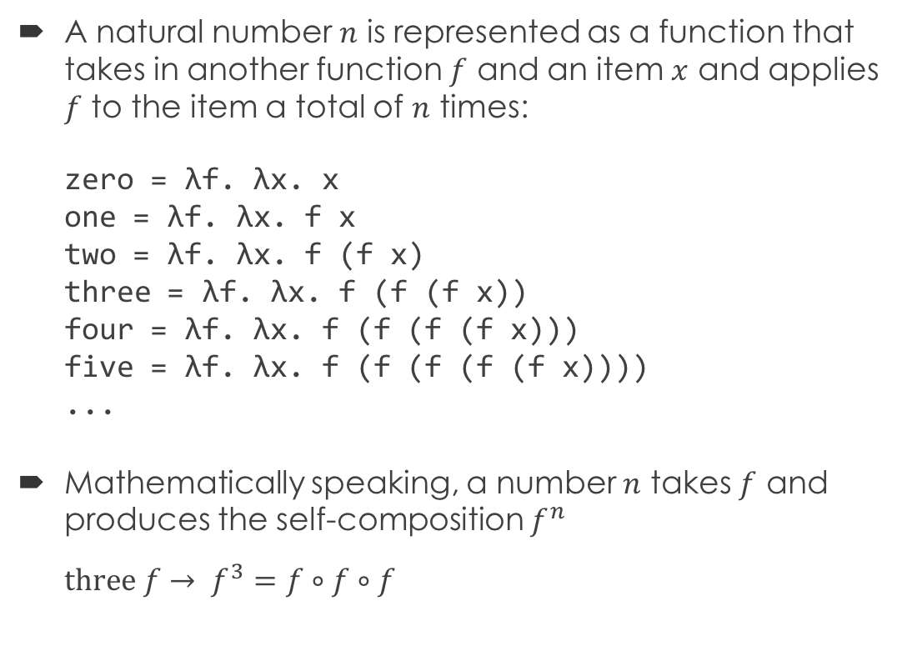
Church Numerals
A natural number $n$ is represented as a function that takes in another function $f$ and an item $x$ and applies $f$ to the item a total of $n$ times: zero = λf. λx. x one = λf. λx. f x two = λf. λx. f (f x) three = λf. λx. f (f (f x)) four = λf. λx. f (f (f (f x))) five = λf. λx. f (f (f (f (f x)))) ...
Mathematically speaking, a number $n$ takes $f$ and produces the self-composition $f^{n}$ $three f→ f^{3}=f∘f∘f$

Slide 18
Increment
zero = λf. λx. x one = λf. λx. f x two = λf. λx. f (f x)
We can increment a number as follows: incr = λn. λf. λy. f (n f y) incr zero = (λn. λf. λy. f (n f y)) zero → λf. λy. f (zero f y) = λf. λy. f ((λx. x) y) → λf. λy. f y = one incr one = (λn. λf. λy. f (n f y)) one → λf. λy. f (one f y) = λf. λy. f ((λx. f x) y) → λf. λy. f (f y) = two

Slide 19
Addition and Multiplication
two = λf. λx. f (f x) incr = λn. λf. λy. f (n y)
We can define addition as follows: plus = λm. λn. m incr n plus two three = (λm. λn. m incr n) two three → (λn. two incr n) three = (λn. (λf. λx. f (f x)) incr n) three → (λn. (λx. incr (incr x)) n) three → (λx. incr (incr x)) three → incr (incr three) → incr four → five
We can similarly define multiplication: times = λm. λn. m (plus n) zero
Apply the incr function m times to n
Apply the (plus n) function m times to zero

Slide 20
Zero Predicate
zero = λf. λx. x one = λf. λx. f x two = λf. λx. f (f x)
Predicate to check for zero: iszero = λn. n (λy. false) true iszero zero = (λn. n (λy. false) true) zero → zero (λy. false) true = (λf. λx. x) (λy. false) true → (λx. x) true → true iszero one = (λn. n (λy. false) true) one → one (λy. false) true = (λf. λx. f x) (λy. false) true → (λx. (λy. false) x) true → (λx. false) true → false
Only results in true if function never applied

Slide 21
Recursion
Functions are anonymous, so need to arrange to pass in function as an argument to itself fact = λf. λn. if (iszero n) one (times n (f f (decr n)))
We also need an auxiliary apply function apply = λg. g g
Decrement function
Pass along function to itself in recursive call

Slide 22
Example
Computing factorial: apply fact m = (λg. g g) fact m → fact fact m = (λf. λn. if (iszero n) one (times n (f f (decr n)))) fact m → (λn. if (iszero n) one (times n (fact fact (decr n)))) m → if (iszero m) one (times m (fact fact (decr m))) =_{β} if (iszero m) one (times m (apply fact (decr m)))

Slide 23
Y Combinator
Also known as a fixed-point combinator Y = λf. (λx. f (x x)) (λx. f (x x))
Applying Y to a function F results in Y F = (λf. (λx. f (x x)) (λx. f (x x))) F → (λx. F (x x)) (λx. F (x x)) → (λx. F (x x)) (λy. F (y y)) → F ((λy. F (y y)) (λy. F (y y))) = F (Y F)

Slide 24
Simpler Factorial
No longer have to pass function to itself
First, define the concrete function F: F = λf. λn. if (iszero n) one (times n (f (decr n)))
Now apply Y to F, and apply result to a number: Y F m → F (Y F) m = (λf. λn. if (iszero n) one (times n (f (decr n)))) (Y F) m → (λn. if (iszero n) one (times n (Y F (decr n)))) m → if (iszero m) one (times m (Y F (decr m)))
Letting fact = Y F, we get fact m → if (iszero m) one (times m (fact (decr m)))

Slide 25
Turing Machine
… | a₁ | a₂ | a₂ | a₁ | a₀ | …
Consists of:
An infinite tape divided into cells, each containing a symbol from a finite alphabet
A head positioned at a cell and that can move left or right
A state register that keeps track of the state of the machine, one of finitely many
A table of instructions that specifies what to do given a state and the symbol currently under the head
Write a specific symbol to the current cell
Move the head one step to the left or right
Go to a new state
S₁
state
Notes:
More of an imperative model of computation.

Slide 26
Church-Turing Thesis
Alan Turing proved that Turing machines solve the same set of problems as λ-calculus
The Church-Turing thesis states that all problems that can be solved by a human using an algorithm can also be solved on a Turing machine
All known computational models are weaker than or equivalent to Turing machines
Equivalent models are Turing complete
A programming language defines a computational model
All general-purpose programming languages are Turing complete

